Slide 1
Location recommendation of venues based on data from Foursquare
Zijie Huang

Slide 2
Contents
Introduction
Data acquisition and cleaning
Exploratory data analysis
Results
discussion

Slide 3
Introduction
Location-Based Social Networks (LBSN), as one of the characteristics of social networks, is also accompanied by the development of these software.
Therefore, it is important for social networks to make personalized recommendations about what they are about to do.
The main purpose is not only to make the user more convenient, but also to produce a series of commercial value.
This report mainly focuses on when the user does not know where to make a new venue and which kind of venue is the best choice, he needs to make specialised recommendations based on the previous queries.

Slide 4
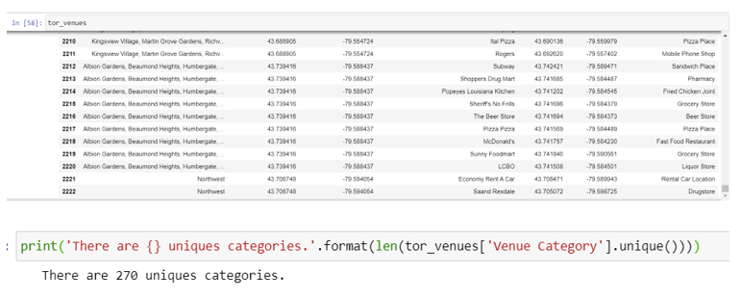
Data acquisition and cleaning
This article uses the POI data set of the user's check-in records in Toronto on Foursquare. Each data records the location category, latitude, longitude and venue.
After data cleaning, 2,223 of 3,000 queries are used for model contributing, which can be classified into 270 categories.

Slide 5
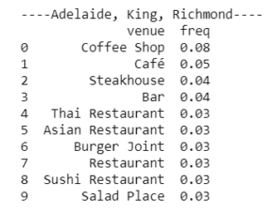
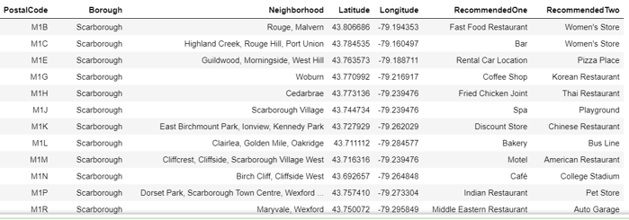
Exploratory data analysis
After making these queries by one-hot method, we can get the frequency of these venues in each areas, and the higher the frequency gets, the more common this venue be in this area.
Based on that, we can get the recommendation model.

Slide 6
Results
From the model, we can get:
Position recommendation of one given venue
Venue recommendation of one given area

Slide 7
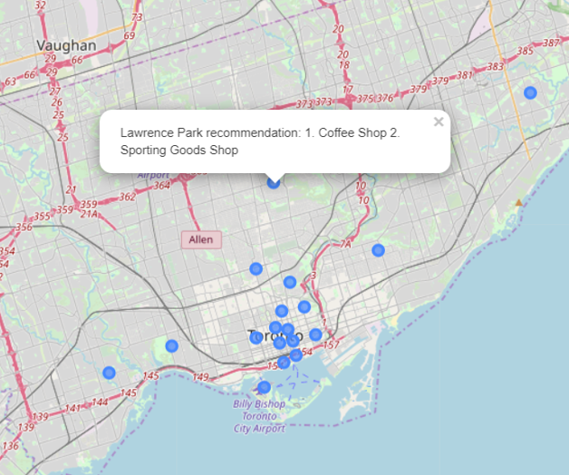
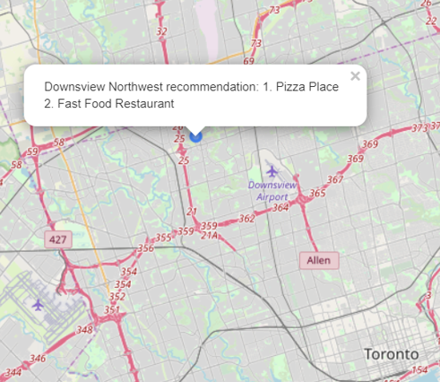

Slide 8
Discussion
There are still some problems:
The framework constructed in this paper is general and can be further expanded in many aspects according to the needs of actual data.
We can further improve the steps and logic of the algorithm.
The calculated results cannot be directly applied to three-dimensional buildings such as department stores.

Slide 9
Thanks !!

